Slide 1
FH-score and AoP-score on Goldbeter
By Michelle Goodman 2/3/2017
Aims:
When will the wave penetrate
Can you Predict the depth of penetration

Slide 2
Introduction
Previously I have been able to look at a given wave profile and decide if it will penetrate past the bifurcation point based on two criteria:
The wave profile of x* must be asymmetric
Ie: must be front-heavy
The frequency of oscillation must increase from x* to x* + dx
Ie: f(x*) < f(x*+dx)
I would now like to quantify the front-heavy-ness of a concentration wave profile as a FH-score

Slide 3
What is an FH-score?
The FH-score represents the maximum net flux of concentration passed from some cell x* to the cell x* -dx
Ie when the FH-score > 0 the wave tends to penetrate

Slide 4
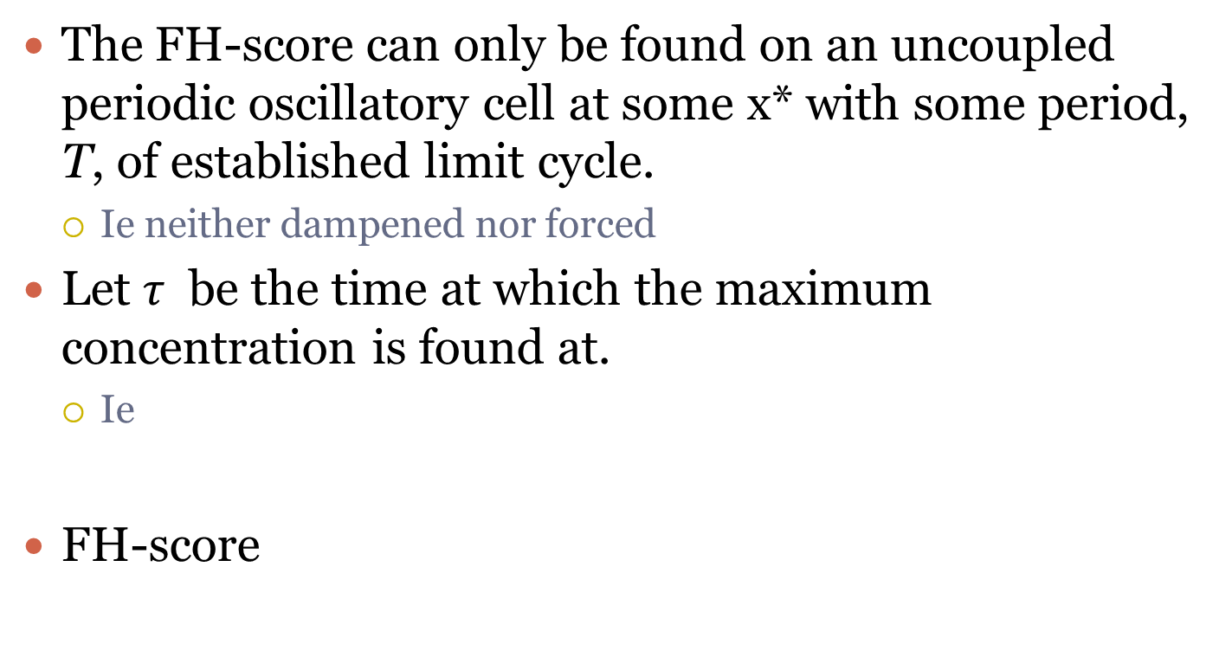

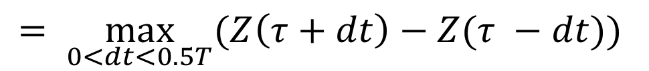
How do you find the FH-score [$μM$]
The FH-score can only be found on an uncoupled periodic oscillatory cell at some x* with some period, T, of established limit cycle.
Ie neither dampened nor forced
Let $τ$ be the time at which the maximum concentration is found at.
Ie
FH-score
$$\max_{t ∈ ℝ_{>0}}{(Z\left(t\right))=Z\left(τ\right),} where ℝ_{>0}=\left\{x∈ ℝ \right|x>0 \}$$
$$= \max_{0<dt<0.5T}{(Z\left(τ+dt\right)−Z(τ −dt))}$$

Slide 5
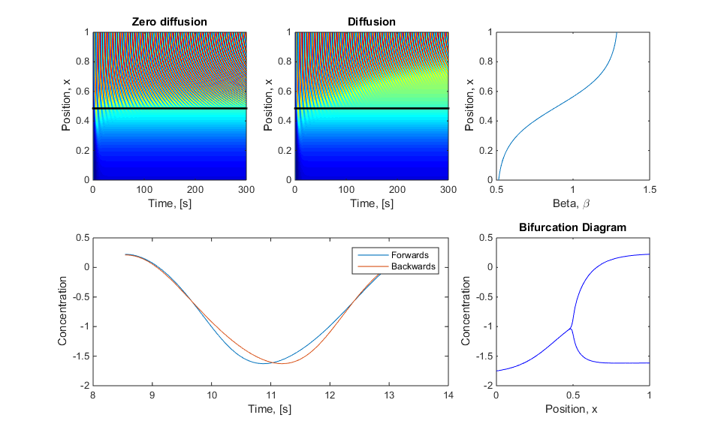
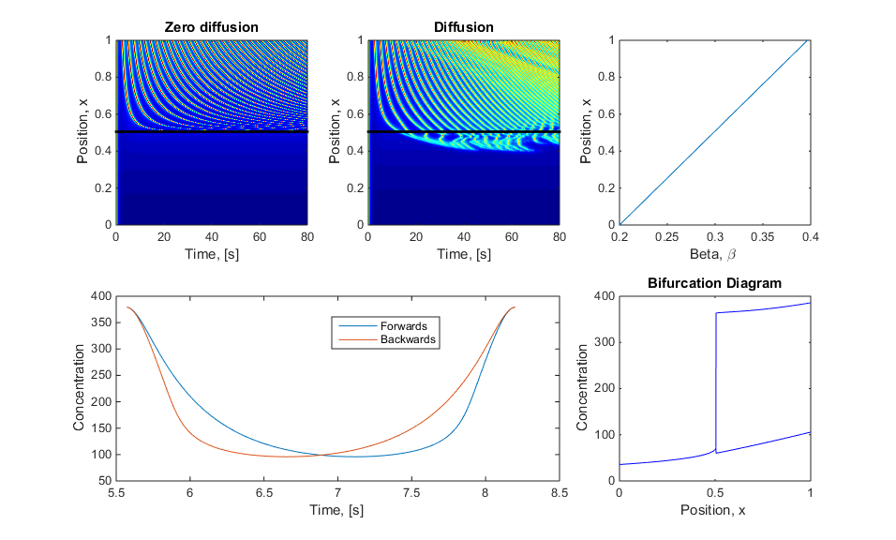
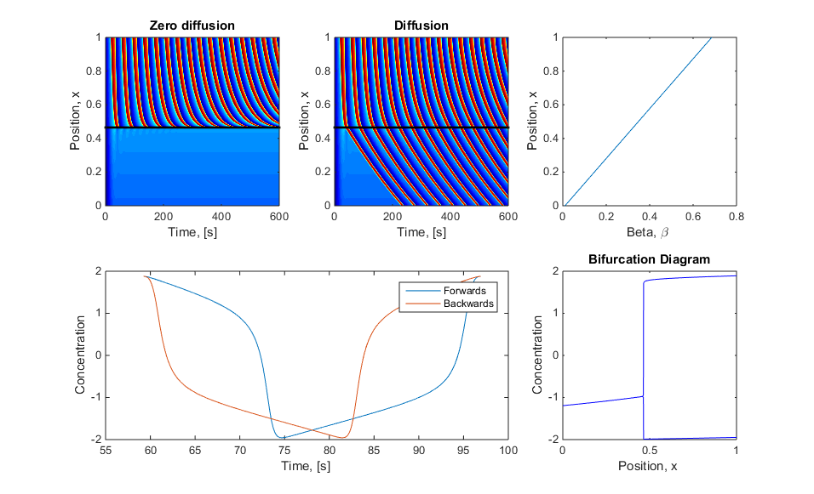
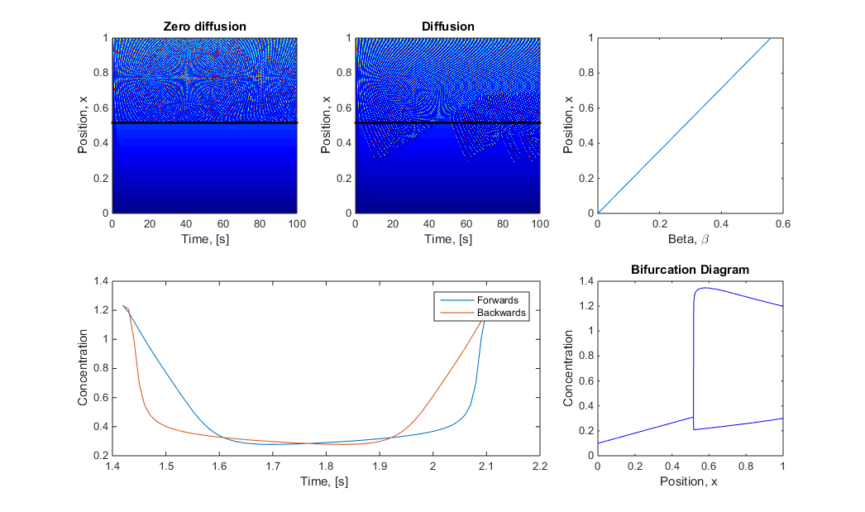
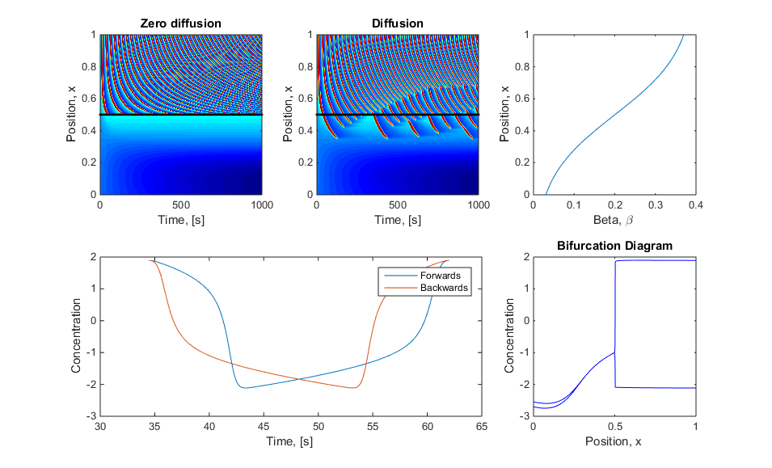
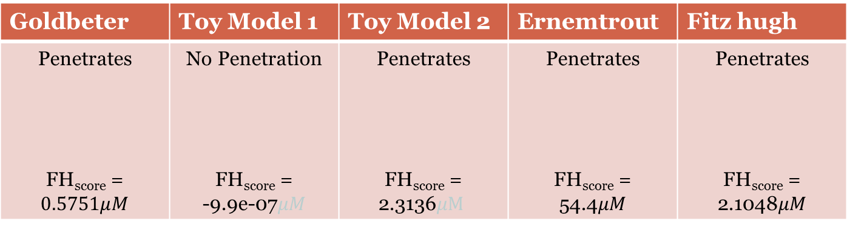
Example of FH-score
Goldbeter | Toy Model 1 | Toy Model 2 | Ernemtrout | Fitz hugh
Penetrates FH_{score} = $$0.5751μM$$ | No Penetration FH_{score} = -9.9e-07$μM$ | Penetrates FH_{score} = 2.3136$μM$ | Penetrates FH_{score} = 54.4$μM$ | Penetrates FH_{score} = 2.1048$μM$
Note: You can find a FH-score for each beta value in the oscillatory region

Slide 6
Is FH-score Enough?
Being able to determine the FH-score tells us if it will be able to penetrate
However, as Paul pointed out, it does not matter what shape the concentration wave is if it is sitting next to a ‘cell’ with a beta value of zero it will not penetrate
NO

Slide 7
New Hypothosis
Not only does the initial criteria need to be met
The wave profile of x* must be asymmetric
FH-score> 0
The frequency of oscillation must increase from x* to x* + dx
But also the cell next door at x*- dx must be potentially excitable given certain/sufficient stimulus
This got me thinking about a ‘cells’ stability when it is perturbed

Slide 8
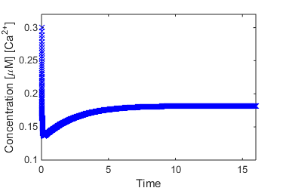



What Do I mean by ‘Stability when Perturbed’
If we take a uncoupled ‘cell’ of some non-oscillatory beta value $β^{∗}$ and found its steady state value:
Initial Conditions
In this case I used:
Goldbeter Model
$β^{∗}$ = 0.2
Z_{ss} = 0.1818 $μM$
V_{ss} = -36.48 $mV$
Y_{ss} = 1.7246 $μM$
Steady state for $β^{∗}$

Slide 9
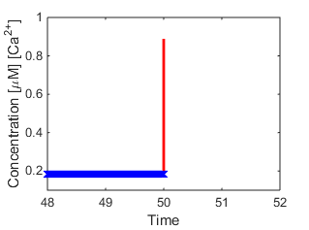

What Do I mean by ‘Stability when Perturbed’
Next we perturbe the cell by adding an amount, P, of [Ca²⁺] concentration to the steady state solution
Z+P
Steady state for $β^{∗}$

Slide 10
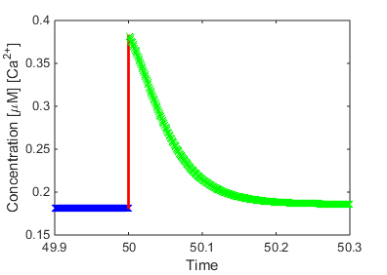
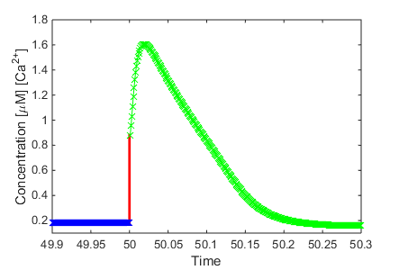



What Do I mean by ‘Stability when Perturbed’
Now the simulation is run until the cell returns back to steady state
Depending of the pertubation P different results are possible:
Small Perturbation, P = 0.2 $μM$
Larger Perturbation, P = 0.7 $μM$
Note: Scales not the same!!
‘Stimulated the cell’
Steady state for $β^{∗}$

Slide 11


What Do I mean by ‘Stability when Perturbed’
Small Perturbation, P = 0.2 $μM$
Larger Perturbation, P = 0.7 $μM$
This time the ‘cell’ has not reacted to the perturbation and will not produce perturbation in the cell below
Here the ‘cell’ has reacted to the perturbation and is likely to produce perturbation in the cell below due to high peek acting as a stimulus
These are an artefacts of common model parameterisation

Slide 12
Question
How can we quantify this excitability of supposable non excitable ‘cells’? Can we use this to capture wave propagation and cessation?

Slide 13
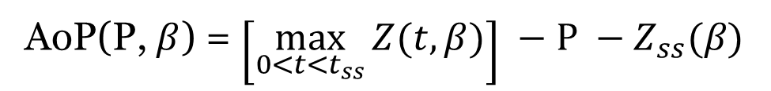
New AoP-score(cell, P)
Amplification of Perturbation score
Where P = Perturbation, Z_{ss} = steady state Concentration, t_{ss} = time to return to ss
Assuming:
uncoupled non-oscillatory ‘cell’
P is an input variable
AoP(P, $β$) = $\left[\max_{0<t<t_{ss}}{Z(t, β)}\right] −P −Z_{ss}(β)$

Slide 14
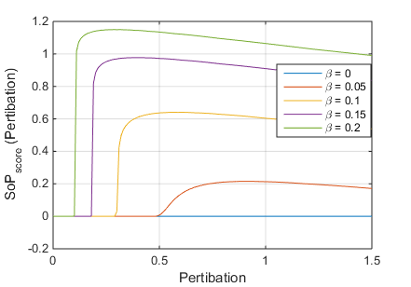
Example of AoP-score
AoP

Slide 15
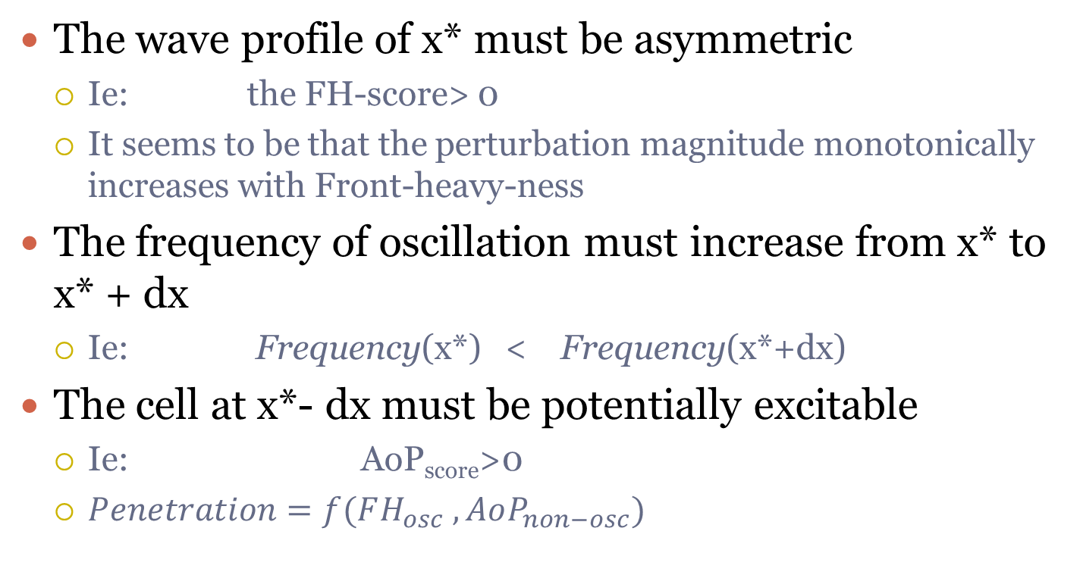
Final Set of Criteria to Penetrate
The wave profile of x* must be asymmetric
Ie: the FH-score> 0
It seems to be that the perturbation magnitude monotonically increases with Front-heavy-ness
The frequency of oscillation must increase from x* to x* + dx
Ie: Frequency(x*) < Frequency(x*+dx)
The cell at x*- dx must be potentially excitable
Ie: AoP_{score}>0
$Penetration=f(FH_{osc} , AoP_{non−osc})$

Slide 16
How far will it penetrate
Based upon the AoP score

Slide 17


How far will it penetrate?
Pert = P
At some position x*
Find AoP(x*, Pert)
$$x^{∗}=x^{∗}−dx$$
$$Pert=f_{1}(AoP)$$
AoP > 0
Yes
No
Penetration Stops

Slide 18
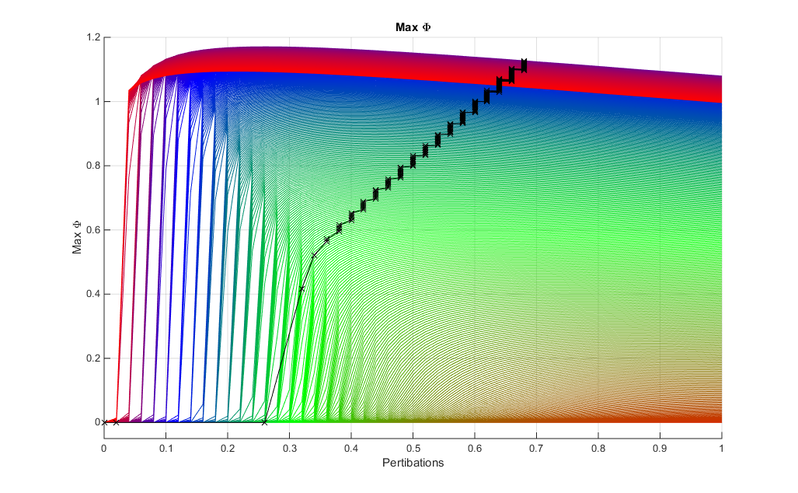


Depth of penetration
Pert = P
At some position x*
Find AoP(x*, Pert)
$$x^{∗}=x^{∗}−dx$$
$$Pert=f_{1}(AoP)$$
AoP > 0
Yes
No
Penetration Stops
AoP(Perturbation)
Each colour line represents a different beta value

Slide 19
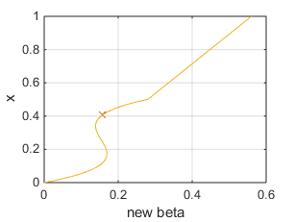
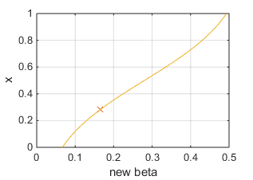
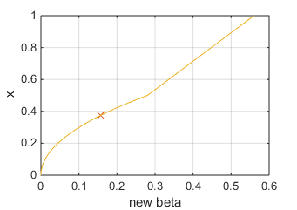
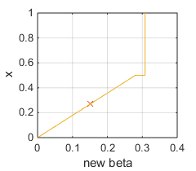
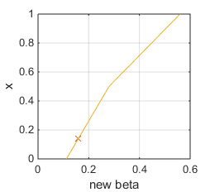
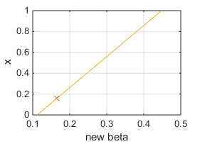
Glory: Predicts Depth of First Wave
See Text Document
For more proof
The method is accurate thus far to a maximum of 0.7% error

Slide 20
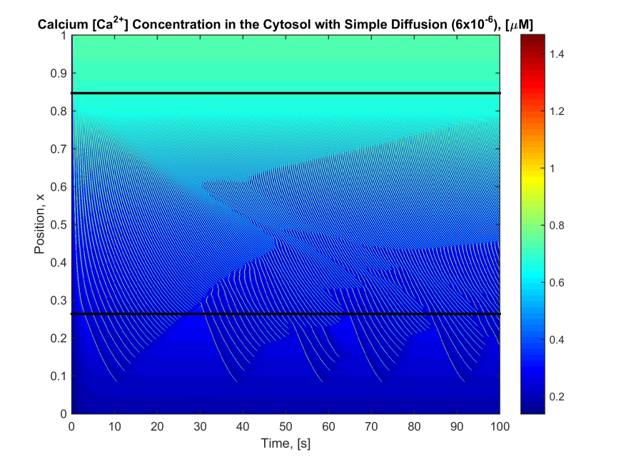
Glory: Predicts the depth of other waves
Each line is the same Goldbeter to different Diffusion values

Slide 21

The Rate
$$Pert=f_{1}\left(AoP\right)=AoP×(a ln\left(wave number\right)+b)$$
where
$$a=a_{1}\ln\left(\frac{D}{dx^{2}}\right)+a_{2} and b=b_{1}\ln\left(\frac{D}{dx^{2}}\right)+b_{2}$$
The wave number only works for the first set that penetrate in the pattern
where a₁, a₂, b₁ and b₂ are:
A1 | A2 | B1 | B2
-0.0305 | 0.0068 | 0.0858 | 0.033

Slide 22

Conclusion
I can predict not just when it will penetrate but to what depth it will penetrate with an 99.3% accuracy!!!
Not just for the first wave but successive waves (following the first initial pattern) as well

Slide 23
Extra slide: How I got a and b

Slide 24
Extra slide: Other parameters
Contributions to a and b may be
Period of oscillation: 2.67s
Area of oscillation: 0.08391
Change in period close to bifurcation: 0.141
Change in area close to bifurcation: 0.00455
It will probably be due to wave shape
None of these work But I don’t think this should stop us from publishing this amazing result

